Slide 1


Final Project Presentation
on
MAZE SOLVING ROBOT
Team Members
B.SAI ABHISHEK BL.EN.U4AIE21015
B.RUCHITH BALAJI BL.EN.U4AIE21017
Chillakuru Hari BL.EN.U4AIE21038
Date:28/06/23
Course :21IAIE213-ROS
Mr RAJESH SIR
AI 4th Sem –E Sec

Slide 2
Outline
PROBLEM STATEMENT
IMPLEMENTATION
RESULTS
CONCLUSION
REFFERENCES

Slide 3
PROBLEM STATEMENT
Designing and implementing a maze-solving robot using ROS2 (Robot Operating System 2) and Gazebo simulation environment
Maze representation
Perception and localization
Path planning and decision making
Robot control and articulation
Simulation and testing
Scalability and robustness

Slide 4
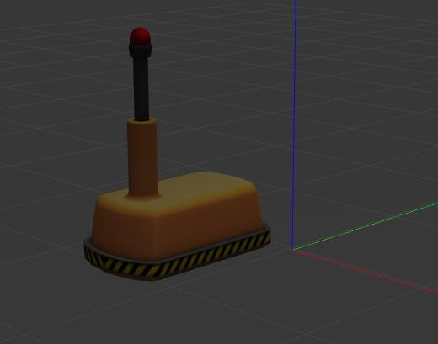
IMPLEMENTATION
MODELS
Robot model
A robot model refers to a representation of a robot's physical structure and its associated properties within the ROS 2 framework.

Slide 5
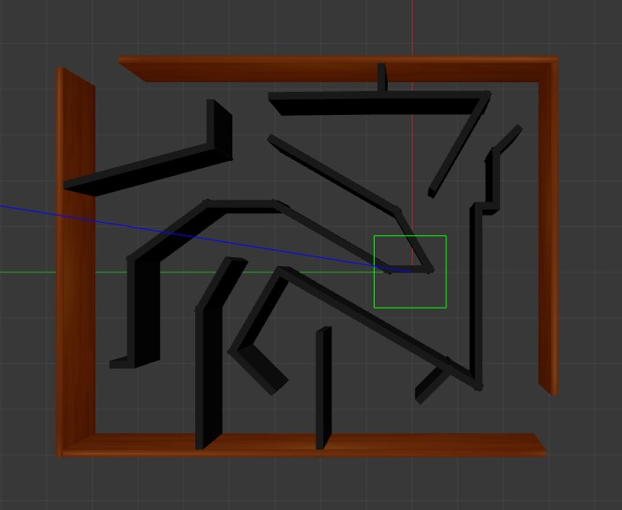

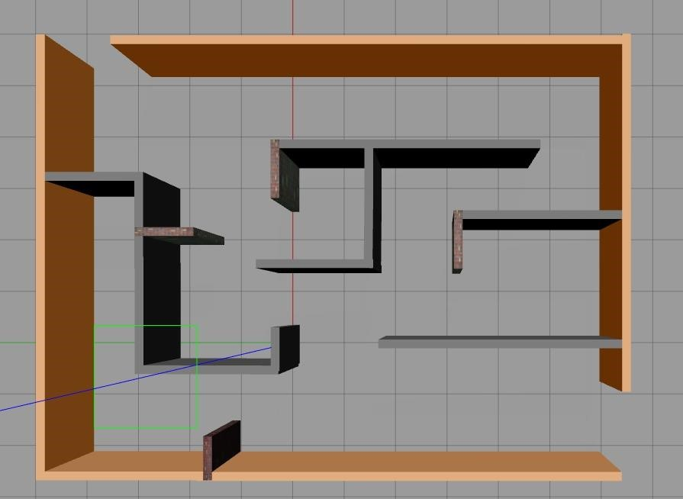
IMPLEMENTATION
Maze models

Slide 6
IMPLEMENTATION
NODES
Spawn demo node:
The Spawn Demo Node is responsible for initializing the maze environment in Gazebo simulation. It loads the maze model, which includes the walls, pathways, and the goal position.
Robot controller node:
The Robot Controller Node is responsible for controlling the movement of the maze-solving robot within the maze
Robot estimator node:
The Robot Estimator Node plays a vital role in estimating and maintaining the robot's position and orientation within the maze.

Slide 7
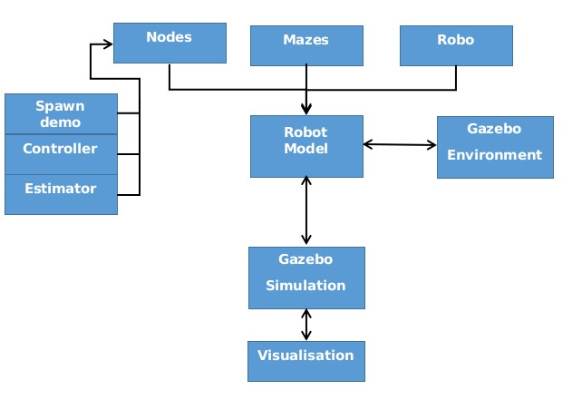
BLOCK DIAGRAM

Slide 8
RESULTS

Slide 9
RESULTS

Slide 10
CONCLUSION
In conclusion, the integration of ROS (Robot Operating System) and Gazebo simulation environment provides a powerful platform for developing a maze-solving robot.
By leveraging the capabilities of ROS2, the maze-solving robot can achieve autonomy, efficient navigation, and intelligent decision-making in complex maze environments.

